Slide 1
XL TestView Training
Level I Training

Slide 2
XL TestView Self Paced Training
Key Concepts of XL TestView

Slide 3
Key Concepts of XL TestView
XL TestView lets you manage, visualize, and analyze tests across all of your test tools to give you a single source of quality truth. XL TestView acts as the Fitbit of your software.
Test Specifications
Projects
Test Runs
Reports and Dashboards
Qualification
Plugins

Slide 4
Key Concepts: Test Specifications
A test specification represents a coherent set of tests. These can be jobs or tasks that include that include automated tests. You can see the results of these tests in dashboards, reports, and qualifications.
There are four types of test specification:
Active test specification: A test specification that can retrieve test results
Executable test specification: A test specification that can execute test runs and import the results
Passive test specification: A test specification to which an external process such as Jenkins can push results
Test specification set: A group that aggregates the results of multiple test specifications
You can create a test specification in the XL TestView interface, by importing existing test results, or by pushing results to XL TestView via Jenkins.

Slide 5
Key Concepts: Projects
Projects combine test specifications into logical groups.

Slide 6
Key Concepts: Test Runs
A test run is the set of results associated with a single execution of the tests in a test specification.

Slide 7
Key Concepts: Reports and Dashboards
XL TestView includes a variety of reports for functional test results and performance test results. Some reports represent a single test run, while others aggregate data from multiple test runs.
You can add reports to dashboards for a quick visual overview of test results. You can also create custom reports.

Slide 8
Key Concepts: Qualification
A qualification is XL TestView’s determination of whether a particular test run passed or failed, based on a configurable analysis of the test results. You can create your own qualifications, and they can be applied to all test specifications, even those that group results from multiple test tools. This allows XL TestView to seamlessly integrate with a continuous delivery pipeline.

Slide 9
Key Concepts: Plugins
XL TestView integrates with your test tools through plugins that search for test results and import results into XL TestView.

Slide 10
XL TestView Self Paced Training
XL TestView Showcase Demo Dashboard

Slide 11
Installing and Starting XL TestView
Download the zip file and extract to the location you wish to run the XL TestView server
By default XL TestView using port 6516. Make sure this port is open and accessible on the server machine. The port can be changed if required.
Depending on your server OS, use terminal or command window to change directory to the XL TestView server root/bin folder
In Linux, run ./server.sh the log will display a message once the server starts, in Windows run start /b server.cmd
In a modern browser navigate to http://localhost:6516 and complete the form for your license. Once submitted you will be able to login with the default user admin/admin
XL TestView is now ready to rock.

Slide 12
XL TestView Self Paced Training
Installing and Starting XL TestView

Slide 13
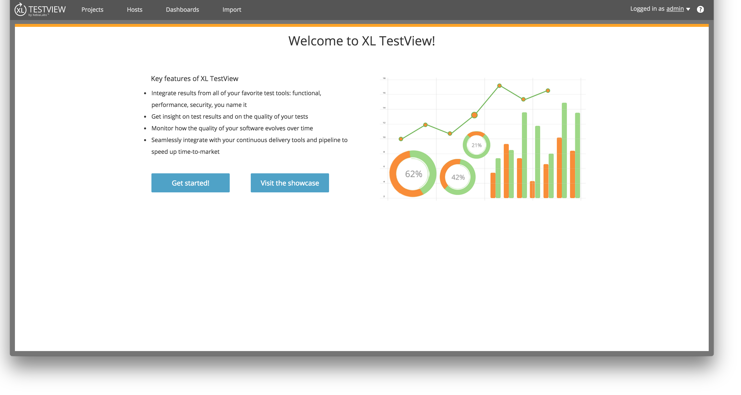
XL TestView Showcase
XL TestView ships with demo test result data presented in a showcase dashboard click Visit the Showcase on the home screen to view the demo Dashboard

Slide 14
Dashboard Overview
The Demo Dashboard is designed to demonstrate the visual power of XL TestView’s customizable dashboards.
Elements in the graphs can be clicked to drill down on the test results to view more detailed test result data
Dashboards can be customized and complete custom dashboards can be created
Test Specifications from different test runs can be combined in a single dashboard
The next two slides is are examples of the Demo Dashboard and the second level of a graph.

Slide 15
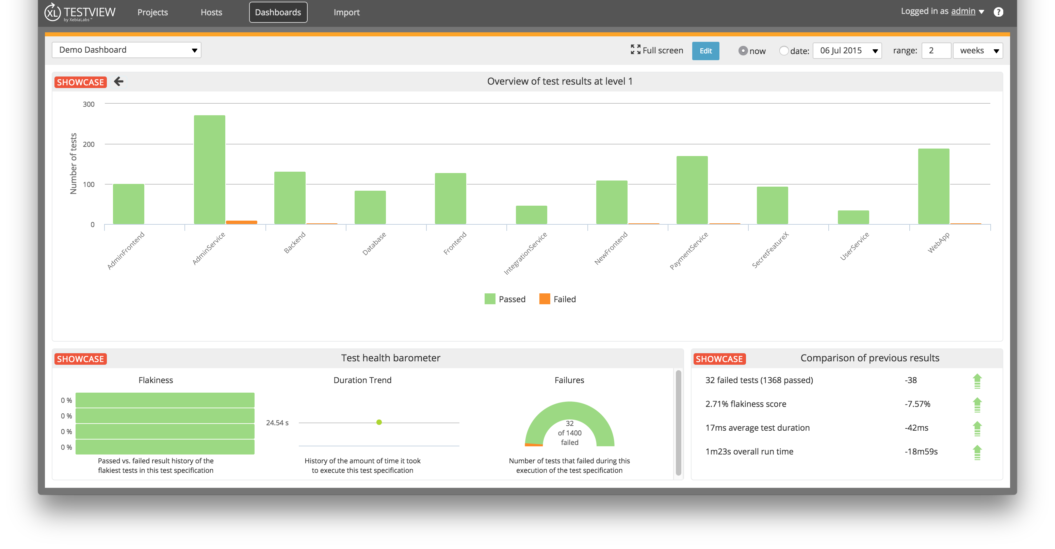
XL TestView Demo Dashboard

Slide 16
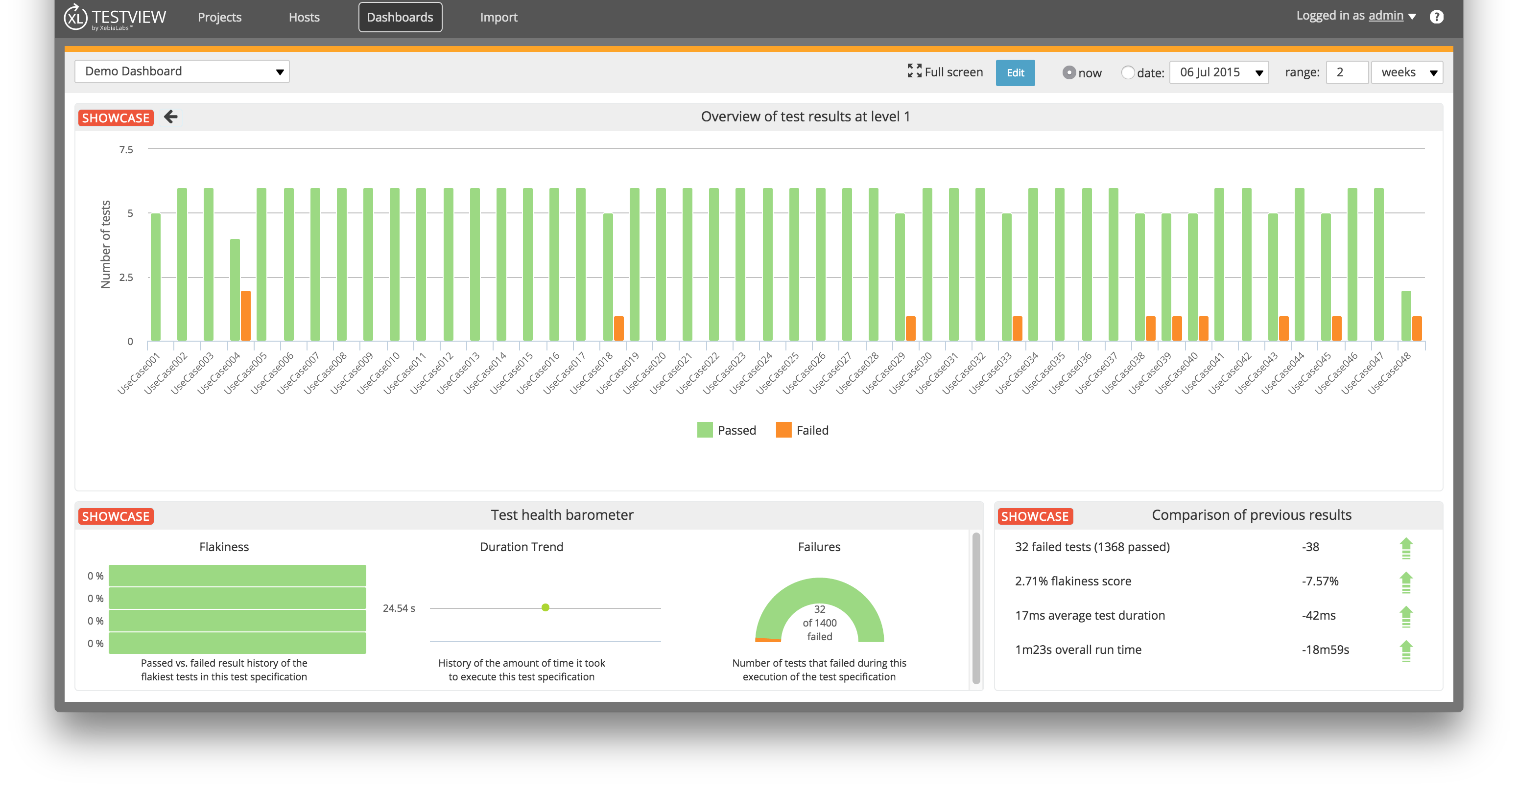
XL TestView Demo Dashboard Level 2

Slide 17
Dashboard Exercise
Using the Demo Dashboard, take some time to customize the layout of the dashboard and the reports currently visualized

Slide 18
XL TestView Self Paced Training
Importing Test Results into XL TestView

Slide 19
Importing Test Results
XL TestView allows you to import existing test result data from your favorite tools. Currently it ships with support for Jmeter, FitNesse, Gatling, Xunit, and Cucumber but can be extended by plugins to include other testing tools. XL Testview also supports exported results in formats used by the listed tools.
Importing test data results is easy in XL TestView.
Click Import on the navigation
Choose the tool from which you want to import from
Choose the location of the server
Enter the directory location where the test results reside
Enter the filename pattern of the test results file

Slide 20
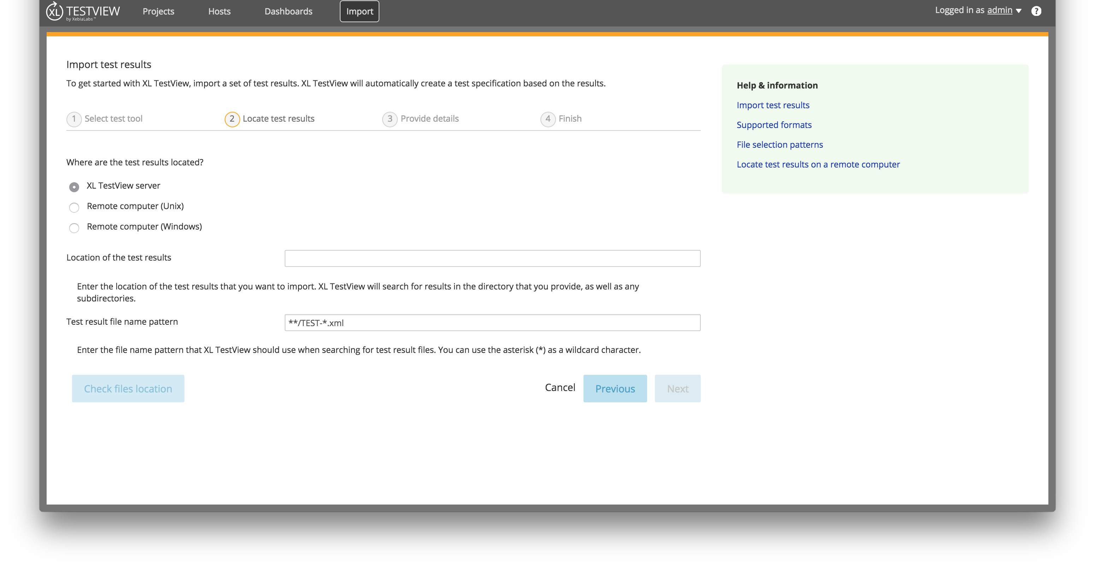
Importing Test Results

Slide 21
Importing Test Results
Choose a Project you wish to import the results into or create a new project
Enter a name for the imported Test Specification

Slide 22
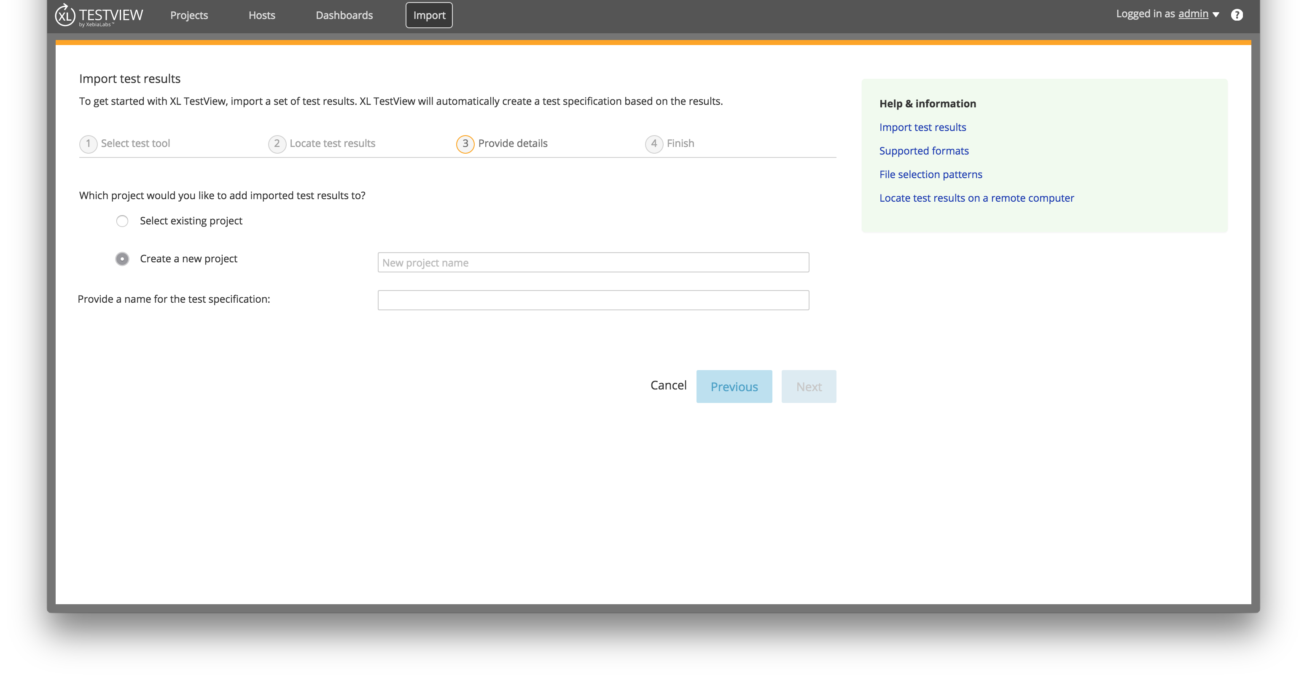
Importing Test Results

Slide 23
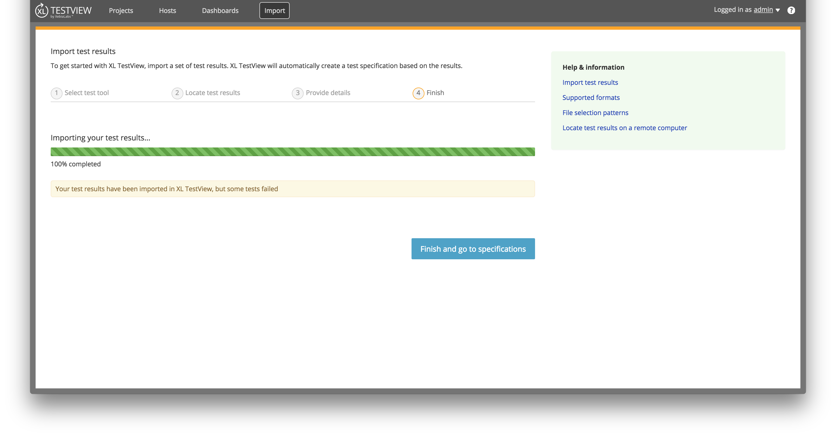
Importing Test Results
Once you click the ‘Next’ button you will see the load bar which signifies the import is complete. Click the “Finish and go to test specification” button to view your new test specification.

Slide 24
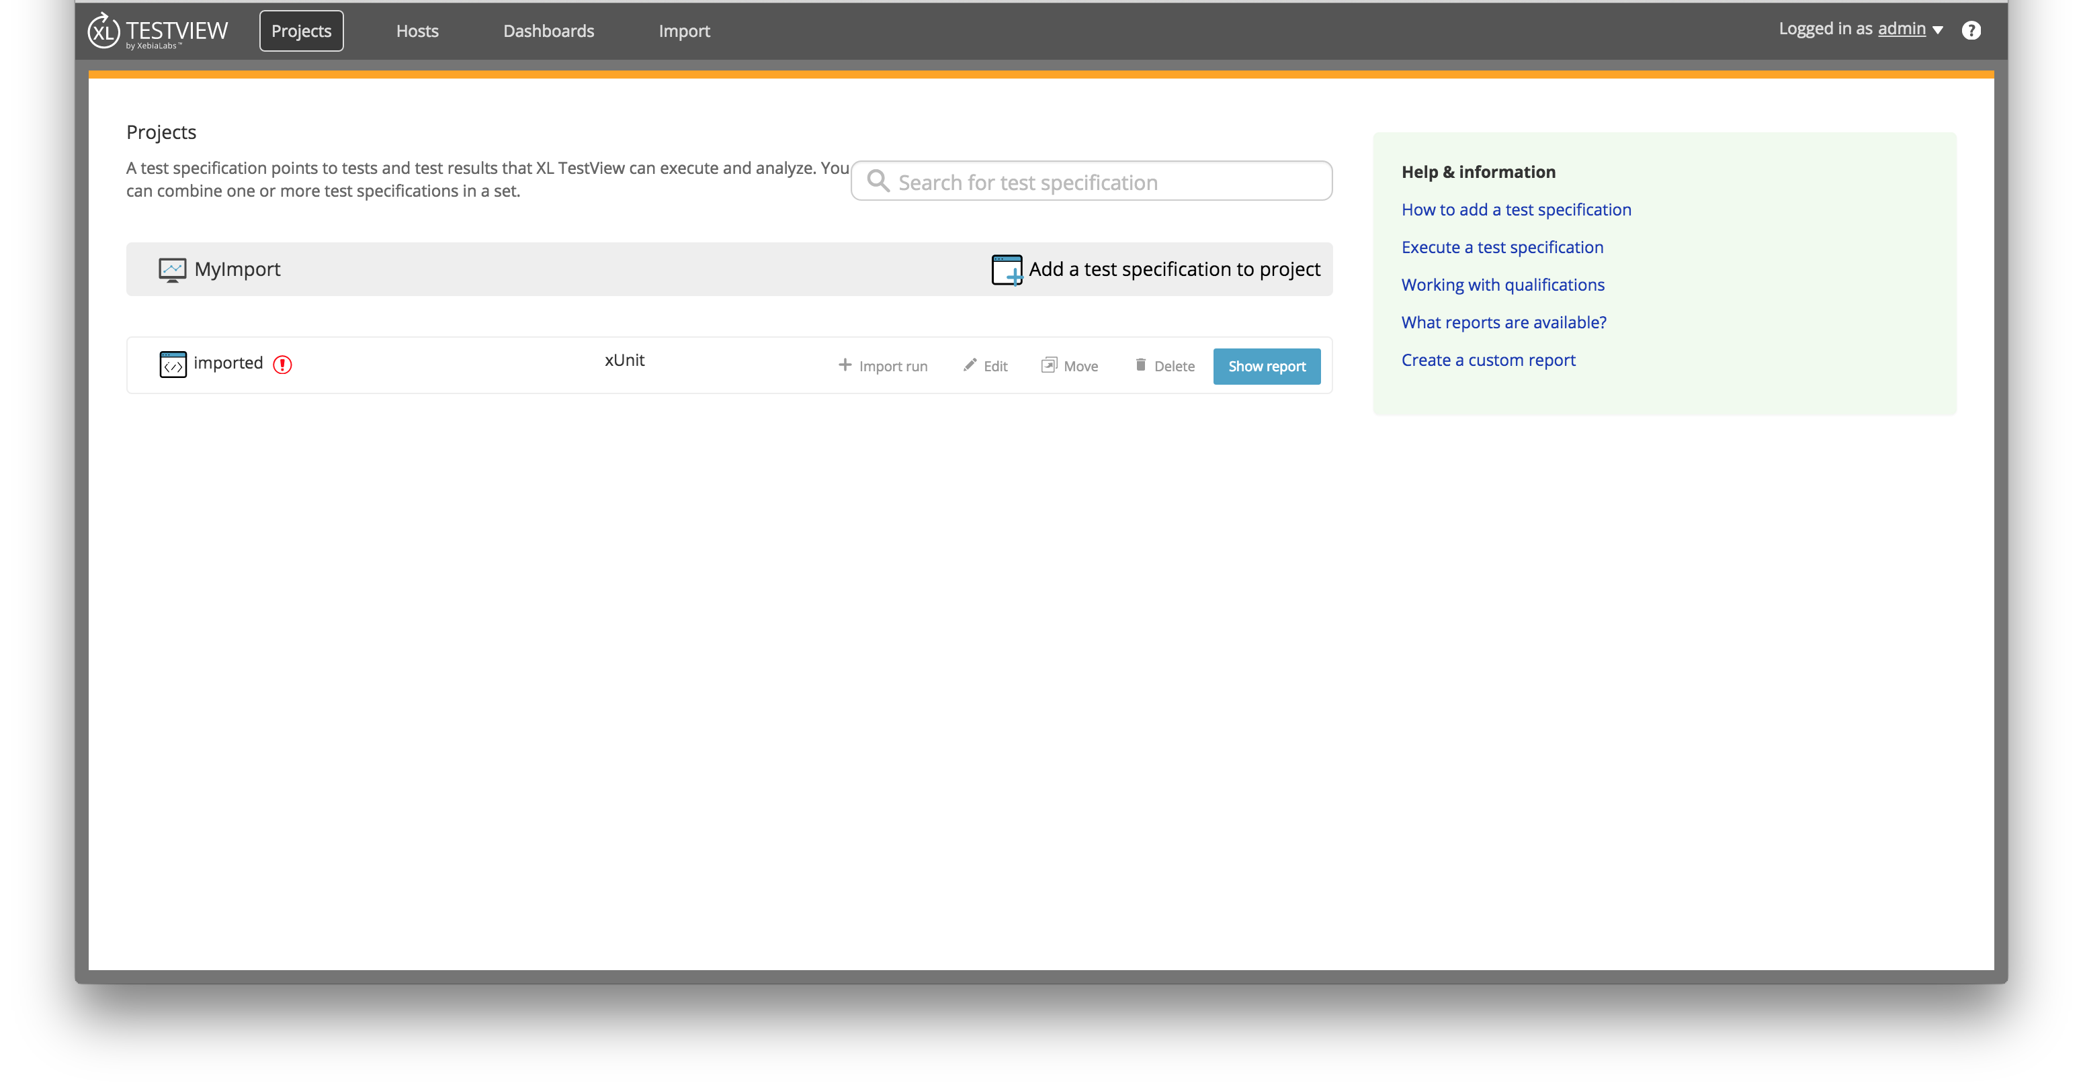
Importing Test Results

Slide 25
Importing Test Results Exercise
Using the provided test results please import them into your instance of XL TestView

Slide 26
XL TestView Self Paced Training
Viewing Reports for Imported Test Results

Slide 27
Viewing Reports
On the navigation click on Projects
Click on the project where you imported your test results in the last exercise
Click on “Show Report”
Choose a report type you wish to view

Slide 28
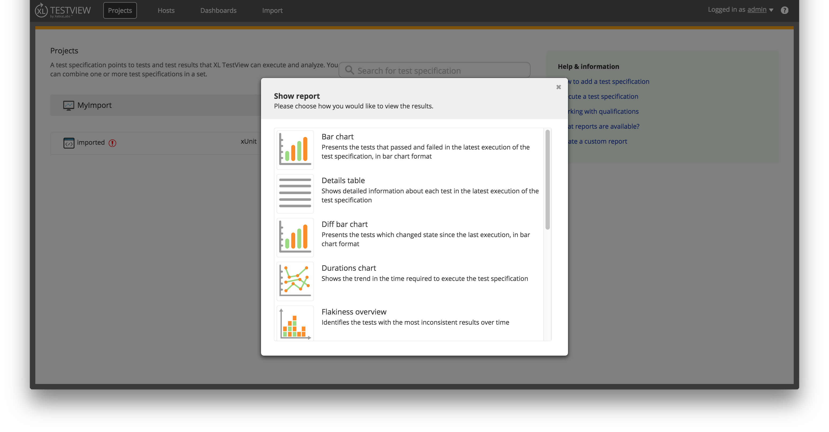
Viewing Reports

Slide 29
Viewing Reports Exercise
View a variety of reports for your imported test results data from the last exercise

Slide 30
XL TestView Training
Creating Test Specifications

Slide 31
Creating Test Specifications
You can create different Test Specifications in XL TestView in your projects.
Click Projects on the navigation menu
Click the project you wish to add you new Test Specification to or create a new project. In this case use the project you created in the previous exercises.
Click “Add a test specification”
Choose the Test Specification type. In this case, please select Passive.
Enter a name for your new Test Specification
Choose the Qualification type that coincides with your new Test Specification
Choose the test tool for the new Test Specification and click “Create test specification”

Slide 32
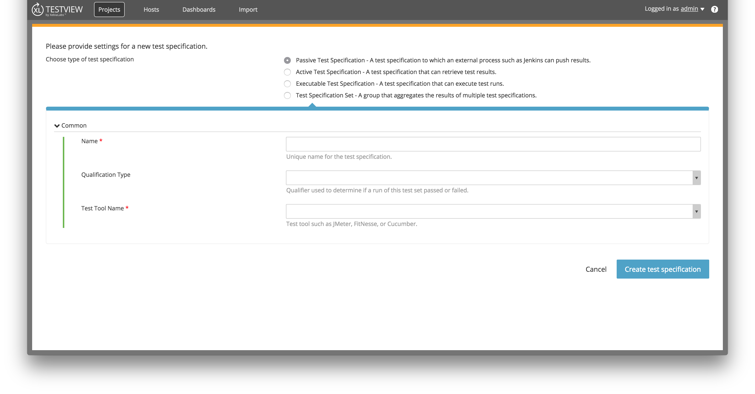
Creating Test Specifications

Slide 33
Creating Test Specification Exercise
Create a new Test Specification in one of your projects

Slide 34
XL TestView Training
Creating Custom Dashboards

Slide 35
Creating Custom Dashboards
In the first part of this training we looked at the Demo Dashboard in the XL TestView Showcase. In this section we are going to create our own custom dashboard.
On the navigation menu click Dashboards
Click the “Add a dashboard” button
Enter the dashboard name
If you wish to copy an existing dashboard choose one on the “Duplicate” drop down
Click “Add dashboard’
Note: Multiple Test Specifications can be added to a single dashboard. Also, Multiple projects can be represented in a single dashboard.

Slide 36
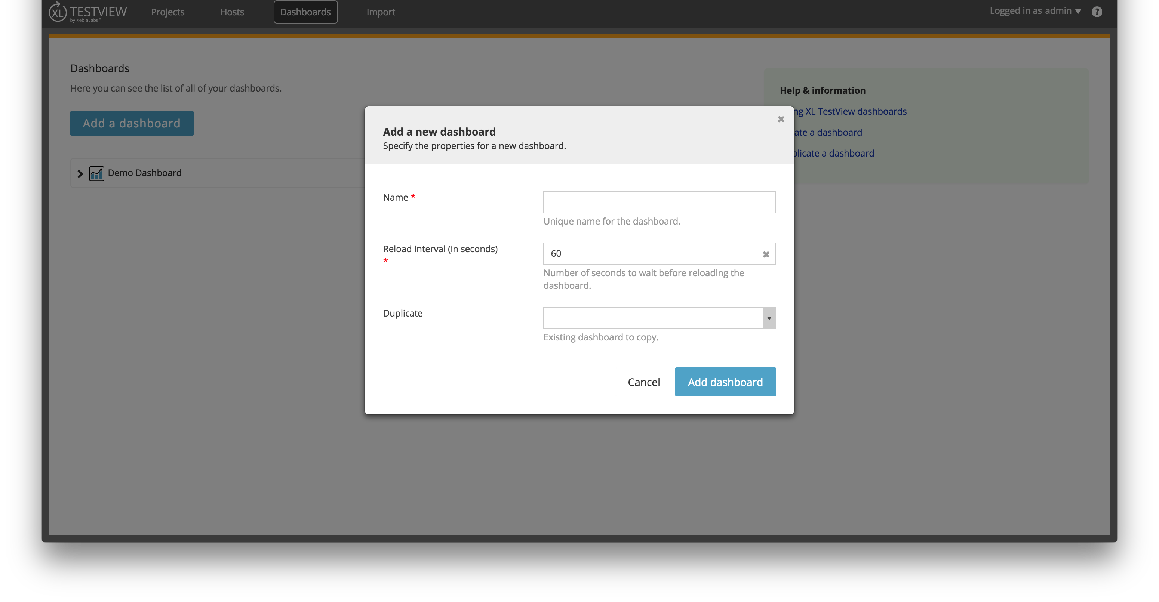
Creating Custom Dashboards

Slide 37
Creating Custom Dashboards
Once you are in the blank dashboard you can begin adding tiles
Click on “Add a tile”
Enter a name for your tile
Choose the Test Specification which you want to report
Choose the Report type which you want to visualize your Test Specification
Click “Add tile”
Resize and drag the tile to the position and size you desire
Click the “Save” button
Repeat for more tiles

Slide 38
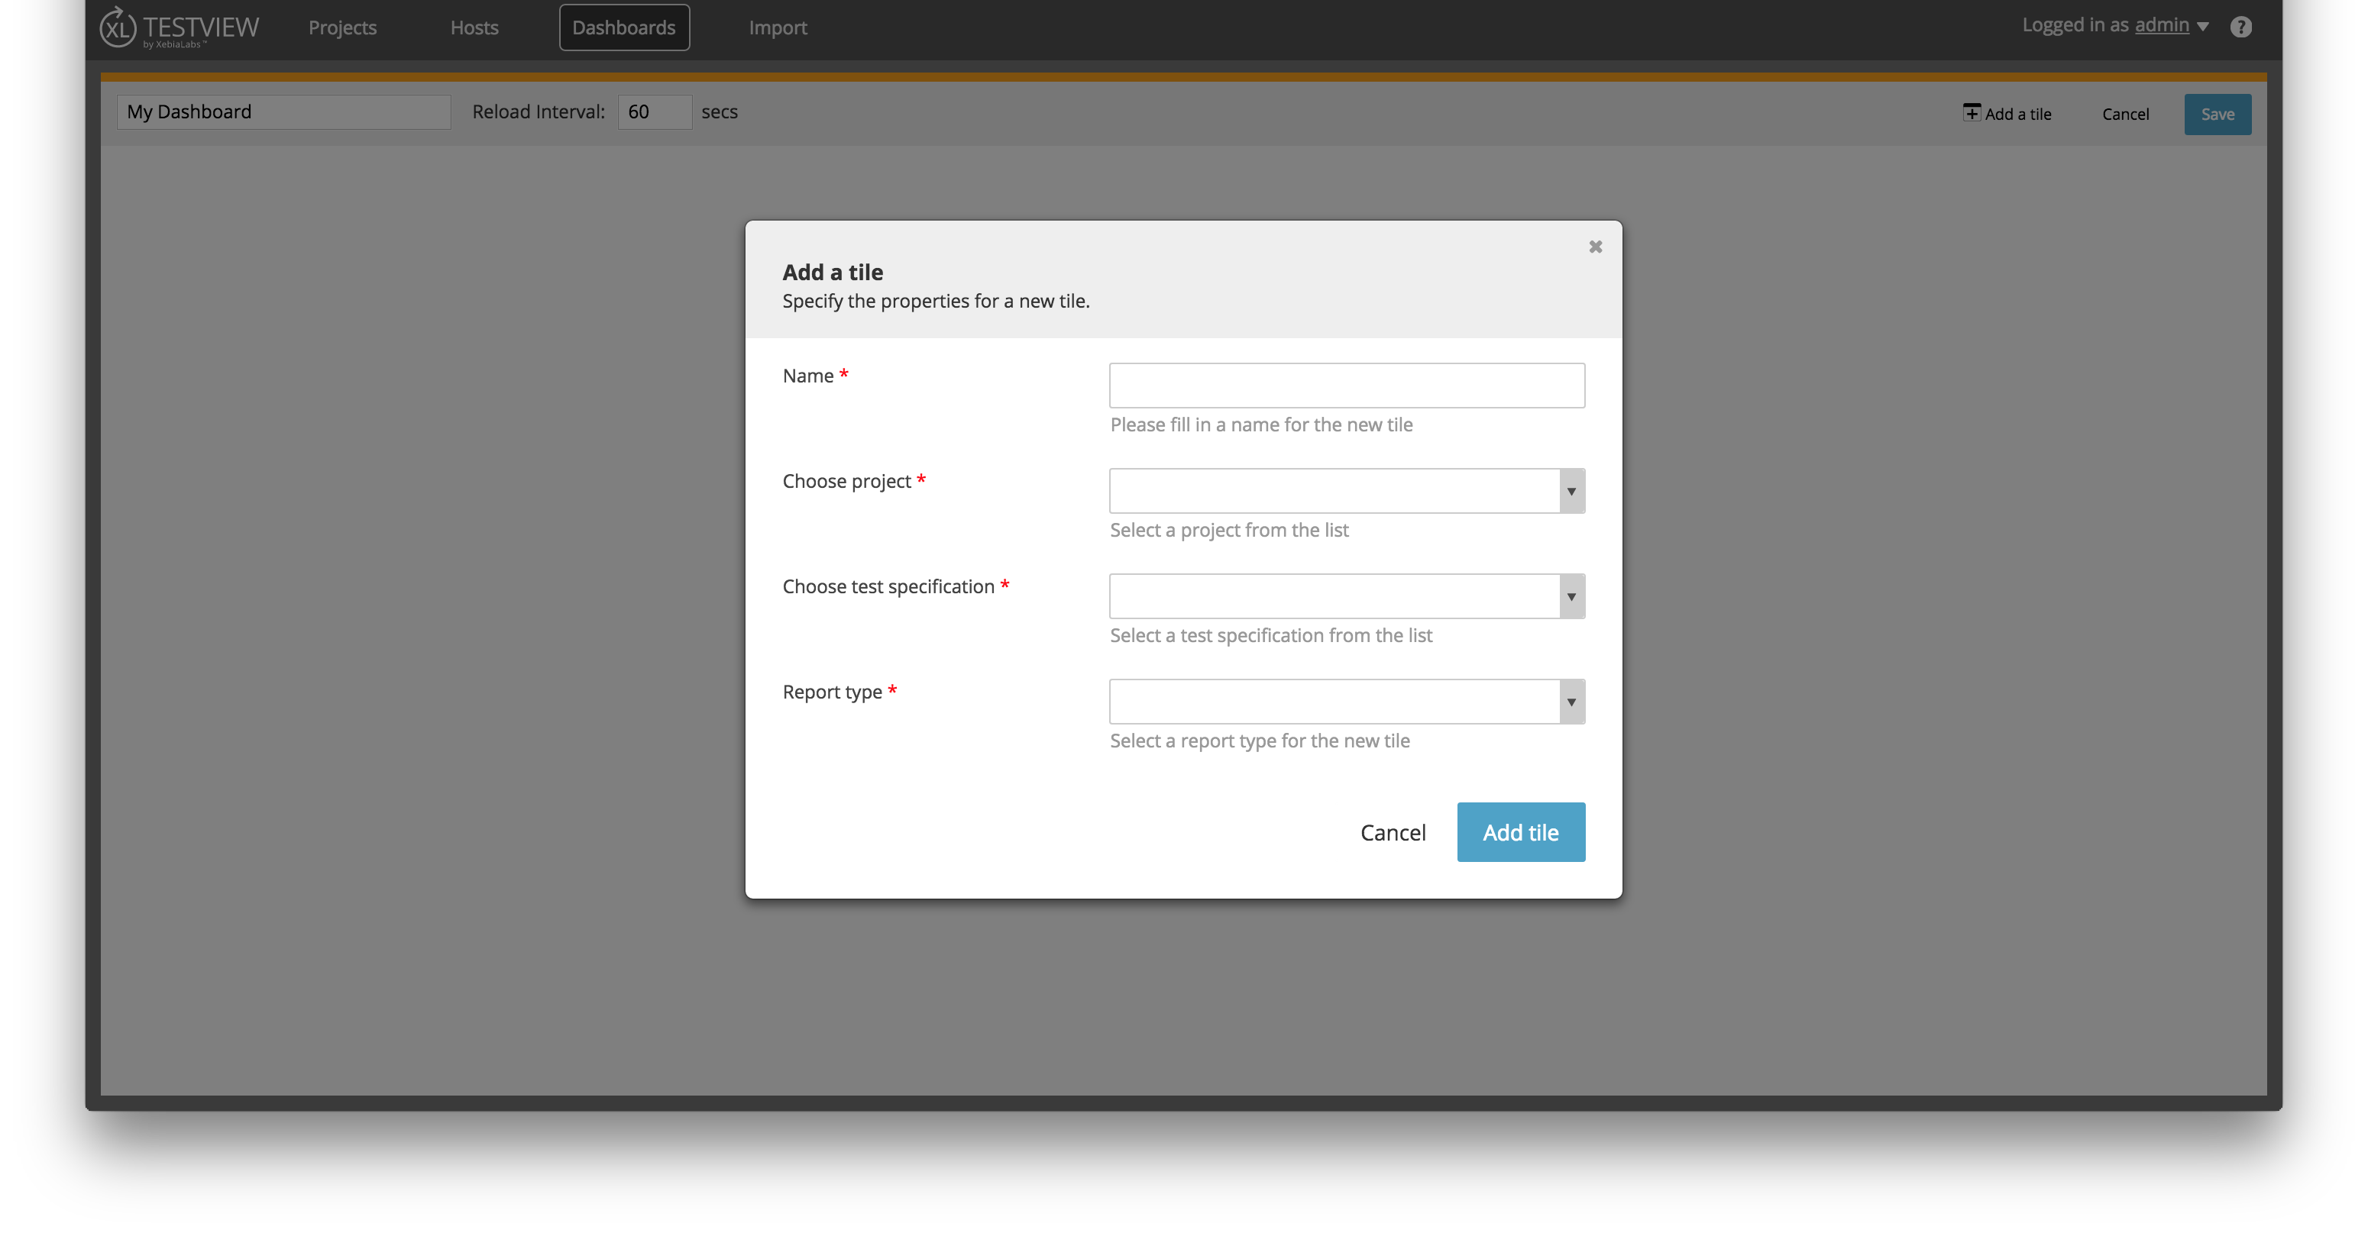
Creating Custom Dashboards

Slide 39
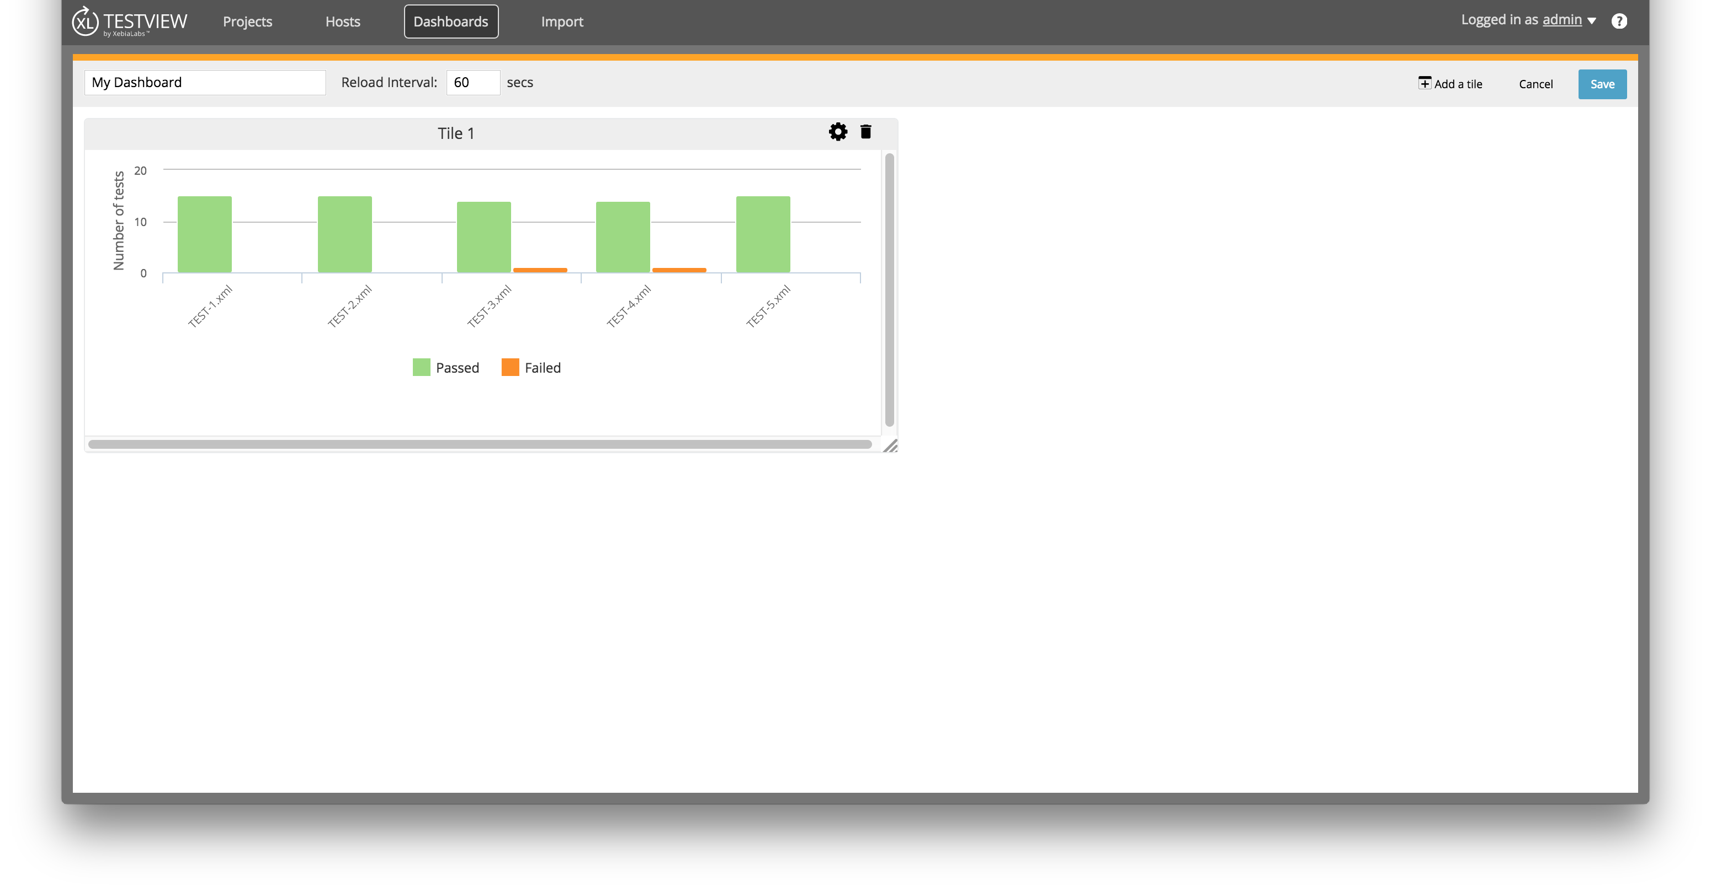
Creating Custom Dashboards

Slide 40
Creating Custom Dashboards Exercise
Using the Test Specifications that you imported create a custom dashboard
Add multiple tiles
Add different report types

Slide 41
XL TestView Training
Connecting Jenkins and XL TestView

Slide 42
Connecting Jenkins and XL TestView
XL TestView can be linked with Jenkins to automatically push results from Jenkins builds in a post build step using the XL TestView Jenkins plugin.
Download and install the Jenkins Plugin for XL TestView in Jenkins
In the Jenkins Settings go to Manage Jenkins > Configure System
Add the server URL and port for your XL TestView server installation
Add the login credentials for XL TestView (admin/admin)
Test connection and Save if successful

Slide 43
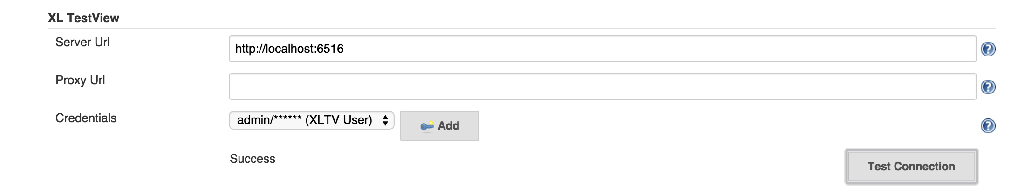
Connecting Jenkins and XL TestView

Slide 44
Connecting Jenkins and XL TestView
In XL TestView create a new Test Specification where you want your Jenkins results to reside. Use the project you created earlier in these exercises.

Slide 45
Connecting Jenkins and XL TestView
The next step in connecting Jenkins and XL TestView is to configure the post build action in Jenkins.
Click on the Jenkins Job you wish to push to XL TestView
Click Configure
Click “Add a post build step” and choose “Send Test Results to XL TestView”
Choose the test specification you wish to push the Jenkins results to. In this case use the test specification you created in the earlier exercises.
Enter the Include Pattern of the test results file. (i.e. */*RESULTS*.xml). This will search for any xml file with RESULTS in it.
Click Save

Slide 46
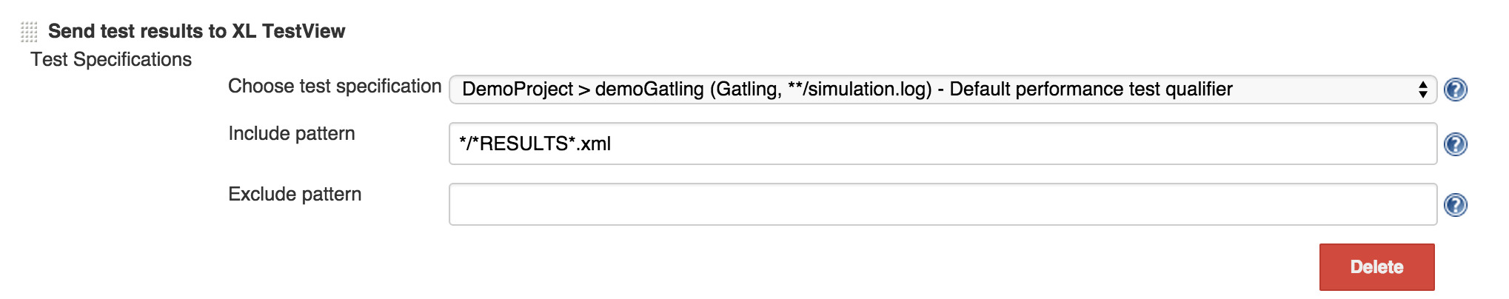
Connecting Jenkins to XL TestView

